Slide 1



Lecture 7: The Recruitment Process
GAM340: Professional Practice
BA(Hons) Game Development

Slide 2
Learning Outcomes
Discover how different companies will advertise jobs
Use appropriate approaches for replying to job adverts
Understand how the selection and interviewing process works
Develop appropriate strategies for dealing with success and rejection

Slide 3
How do companies ‘do’ recruiting

Slide 4
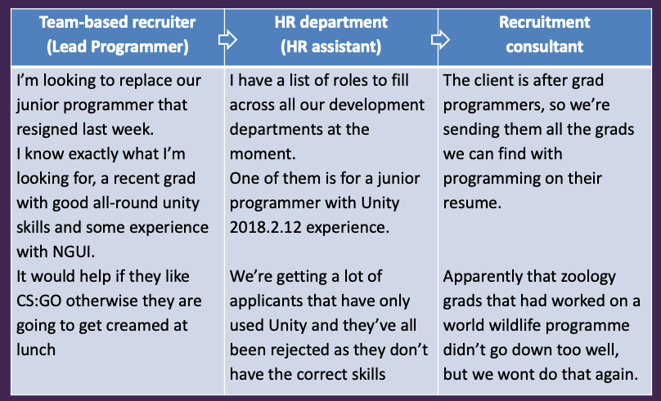
How do companies ‘do’ recruiting
In-house
Recruitment
Outsourced
Recruitment
Notes:
In lecture 5, we looked at a recruitment process. However, not all companies will use recruiters, some will handle recruitment themselves.
Recruitment consultants typically change 15-25% of initial salary to clients, so it doesn’t always make sense to use them.

Slide 5
How do companies ‘do’ recruiting
Company | In-house recruitment | Recruitment consultancy
Indie game Co. (sparse recruitment) | Use social networks May use placement ads (Edge, LinkedIn, Gamastura) | Probably unlikely to want to pay fees
Game Co. (recruiting < 20 people) | As above May avoid, due to time spent doing recruitment | Likely to outsource non-game dev activities
Large Co. (recruiting lots of people) | Bring recruitment inhouse to HR/Talent dept. | Will probably use recruiters to augment selection process
Notes:
This isn’t cast in stone. However,
Generally, v.small companies will do recruitment in-house because of the cost of recruitment. At 25%, every four developers you hire through a consultancy, you could have had a free developer.
For medium sized companies, they are likely to prefer recruiters as they are effectively out-sourcing activities they don’t really have the bandwidth to deal with. The cost of recruitment may still be cheaper than the cost of doing inhouse recruitment
Larger companies, will generally look to recruit in-house as it’s more cost-effective than using consultants. However, they are likely to also use consultants to increase their reach, particularly for more difficult to source roles.
Should also include mates introductions

Slide 6
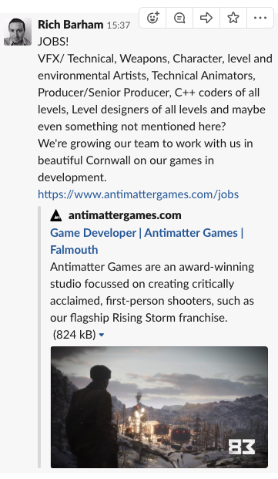
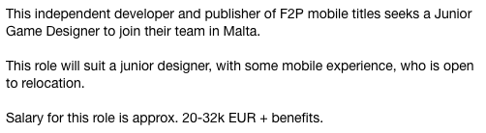
How do companies ‘do’ recruiting
Notes:
In-house recruitment (left)
This is a posting for multiple jobs, but the job ad is very rich in details:
-who the company is
-what the game is
-where the company is
-links to more info
Recruiter (right)
-job is a mystery

Slide 7
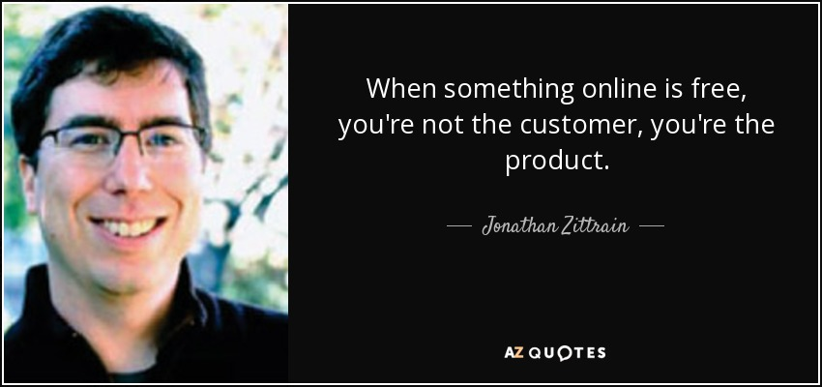
How do companies ‘do’ recruiting
Notes:
With recruiters it’s worth remembering that you are the product and you do not pay for the service
Recruiters get paid by placing candidates, so they have a super-vested interest in getting you placed
In some cases, this is not to the benefit of the candidate. Recruitment consultants generally do not offer career advice, especially when they say they do ;)

Slide 8
Applying for Jobs

Slide 9
Applying for Jobs
Through recruitment agencies
Find jobs of interest on websites (LinkedIn, recruiter websites)
Email / phone recruiters to discuss opportunities
Place resumé with agency
Rinse and repeat
Recruiters will manage the process and get back to you with feedback / interviews
Notes:
Remember, recruiters get paid by placing you.
To do that, they need your resumé to represent you, so don’t feel bad when they ask for you it.
Common to have some kind of consultation about what you want to do, what kind of things you do and don’t want to work on and where you are prepared to work.
I would suggest that you are as open to new experiences as you can be. A lot of success in the industry comes from what you have done in the past. So, it’s better to work on something that you don’t really care for rather than hanging on for a dream first job.
Dimitris from week 2 is a good example of this crappy db role -> Namco -> Sony -> Sky

Slide 10
Applying for Jobs
Direct applications
Write a nice cover letter / email
Don’t make it too short / long
Don’t sound like a complete fanboi / fangirl
Cover the points raised in the job ad
Typically
Genre
Technical skills
Role fit

Slide 11
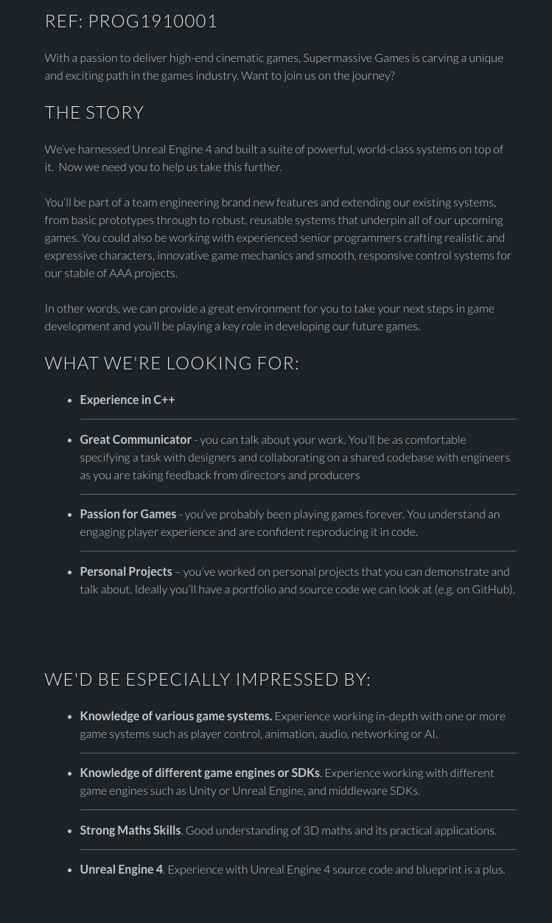
Applying for Jobs
Direct applications
Key deliverables
High-end cinematic games
Experience in C++
Communication with other disciplines
Passion for Games (sic)
Personal projects
Programming smarts (AI, control, anim)
SDK experience
Maths
UE4

Slide 12
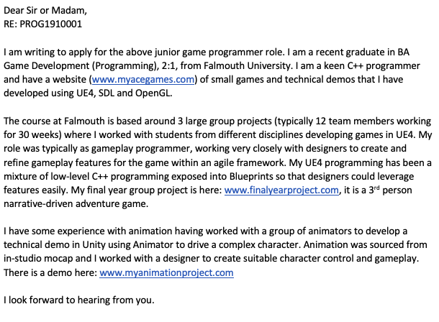
Applying for Jobs
Direct applications

Slide 13
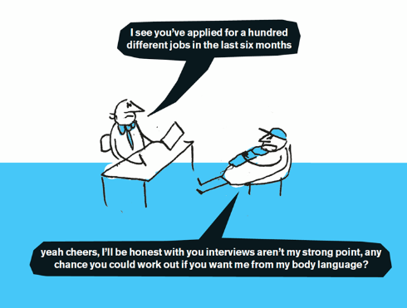
The selection process

Slide 14
The selection process
All companies tend to do the same thing with interviews
But not necessarily in the same order
Goal of recruitment:
Find an employee
Smart & gets things done
Can fit into company / team culture

Slide 15
The selection process
Typical activities
Technical Screening
Phone / Skype Interviews
Take-away tasks
HR Interview
Initial interview
Follow-on interview(s)
On-site test
Final Interview
For all face-to-face interviews, don’t dress up or down too much

Slide 16
The selection process
Typical activities
Technical Screening
Used a lot in programming
Candidate performs programming test online through test provider
www.codewars.com is good preparation for this
Phone / Skype Interviews
Take-away tasks
HR Interview
Initial interview
Follow-on interview(s)
On-site test
Final Interview

Slide 17
The selection process
Typical activities
Technical Screening
Phone / Skype Interviews
Initial interview to reduce cost of interviewing
Typically fairly soft and easy going, more to see about fit than anything else
Take-away tasks
HR Interview
Initial interview
Follow-on interview(s)
On-site test
Final Interview

Slide 18
The selection process
Typical activities
Technical Screening
Phone / Skype Interviews
Take-away tasks
Candidate is given a ‘task’ to do.
Create a concept from a brief
Create a model from a concept
Skin and animate a model
Blockout a level based on a sketch / theme
Add gameplay to a blockout
Add code to something
Create audio for a scene / asset etc
Like a technical screen but more so
Watch out this isn’t some kind of free work scam

Slide 19
The selection process
Typical activities
Technical Screening
Phone / Skype Interviews
Take-away tasks
HR Interview
Interview with HR dept.
Often first part of day session at company
Generally, just orientation and check work status
Initial interview
Follow-on interview(s)
On-site test
Final Interview

Slide 20
The selection process
Typical activities
Initial interview
A proper interview, with people you are likely to be working with
Stages:
Ice-breaker
What have you done? (fit for role)
Team fit
Open-ended questions
Future plans
QA
Follow-on interview(s)
On-site test
Final Interview
Notes:
Ice-breaker
Some easy conversation to get the candidate relaxed and comfortable.
If you find small talk hard work, go practice. Talk to people in shops for 6 months
Fit for role
What have you worked on, how do you solve problems, how do you make assets
Generally, are you capable of doing the work we have for you (Smart & gets things done)
Team fit
How do you deal with soft issues?
Do we want to have you on the team
Open-ended questions
Questions to see how you solve problems and deal with issues
This is where the whiteboard may come out
Again, this is fit for role and team fit
McConnell: ‘If you’re going to hire a juggler, you expect to see them juggle’
Future plans
Where do you see yourself going?
This is mainly to get a feel for the candidate and to see if their plans tie up with yours, no matter how loosely
QA
Your questions for us

Slide 21
The selection process
Typical activities
Initial interview
QA
[show you are enthusiastic and interested in the role, give some impression of long-term-ness (at least to the end of the project)]
How does the interview process work / what happens next?
Can you tell me about your pipelines / processes?
What would a typical day here look like for me?
What do you want me to do on the project?
etc
Don’t say:
When will I get promoted?
What are the clubs like round here?
How long will it take to work on a better project?

Slide 22
The selection process
Typical activities
Initial interview
Follow-on interview(s)
Often, more of the same
Perhaps digging into different aspects of your resumé / experience
Typically, a large studio may be hiring for lots of XX roles and you will go from team to team to do interviews
This will be N x initial interview
On-site test
Final Interview

Slide 23
The selection process
Typical activities
Initial interview
Follow-on interview(s)
On-site test
Some companies will bring a candidate in for 1-2 days onsite ‘working with the team’
See how you fit
Make sure you are fairly gung-ho and hands-on for this
Will often involve a lot of getting pissed: don’t throw up and don’t bad mouth people
Think about taking up smoking to get more involved with the team (if a lot of them smoke / vape)
Final Interview

Slide 24
The selection process
Typical activities
Initial interview
Follow-on interview(s)
On-site test
Final Interview
Interview with super-boss
Normally a check for fit
And a chance to sell the company to you
May involve compensation discussion
Don’t price yourself stupid

Slide 25
Dealing with the outcomes

Slide 26
Dealing with the outcomes
Two outcomes
Success
Failure
Failure is the most common outcome
Don’t be surprised to get rejected
It is a numbers game
Don’t get too hung up on dream jobs
Stay in the saddle

Slide 27
Dealing with the outcomes
Failure is the most common outcome
Don’t ask for feedback
Companies are reluctant to give any, given potential for liabilities
‘We thought you were a very strong candidate, but we offered it to a candidate that better fitted the role’
Don’t go postal
The industry is small and burning bridges before you’ve stepped on them wont help you
The industry is very connected
Don’t over-analyse your failures
But do look at any obvious issues that may have occurred.

Slide 28
Dealing with the outcomes
Success
If you have an acceptable offer on the table, my advice is to take it
The experience you’ll get with the firm (even if it’s a crappy job) will be better than most things you can do at home
Don’t worry about more job hunting until:
a) a reasonable amount of time has elapsed and you feel like working somewhere else
b) the firm has collapsed,
c) you’ve been laid off.
It’s not unusual for grads to switch jobs fairly frequently (say 18-36months) in the first few years of employment, given that a lot of the work you will be doing is project-based
Notes:
See Dimitris

Slide 29
Dealing with the outcomes
Success : one in the hand
What if I have a job offer but I like another company I’ve applied for more
This is hard, you can take the offer and wonder what would happen with the other role
Or, reject the offer and hope the other role is better (and that you get it)
You need to make your own decision, but remember not to mess companies around
The industry is small, and people don’t like rejection
At the start of your career, you want to try and avoid burning bridges
Notes:
SONY getaway bloke

Slide 30
Wrap-up
Good recruitment is all about planning
Work out what you want to do and practice your skills to demonstrate that you can do it
Don’t be too intimidated by interviews
Deal with the outcomes in a professional way
All experience is good experience
Crappy game jobs are well worth taking as they will lead on to bigger and better things
Notes:
SONY getaway bloke

Slide 31
Questions

